Slide 1
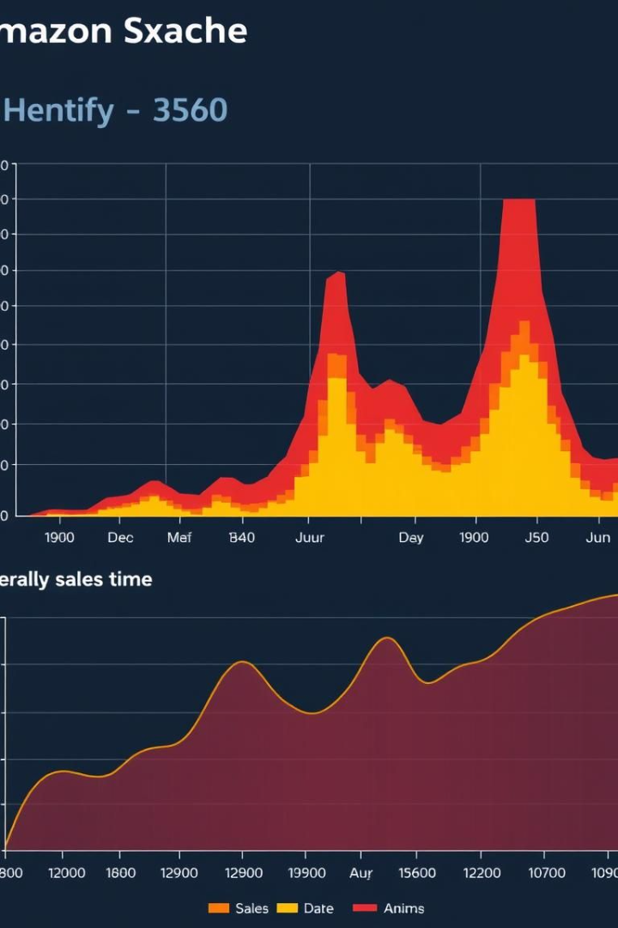
Amazon Sales Analysis: Power BI Project
This presentation provides an overview of the Amazon Sales Analysis Power BI project. It covers project goals, data sources, key metrics, and Power BI tools.
The goal is to analyze Amazon sales data to identify trends, optimize performance, and drive business growth.
Manish Kumar Singh (14459)
Mohit Singh Sekhawat (13632)
Section- G
Course- B.Tech CS

Slide 2
Data Acquisition and Preparation
Data Extraction
Data Transformation
Data Loading
Amazon Seller Central API for sales and orders.
Cleaning and shaping data using Power Query.
Importing data into Power BI data model.
Amazon Advertising API for campaign data.
Handling missing values and data type conversions.
Establishing relationships between tables.

Slide 3
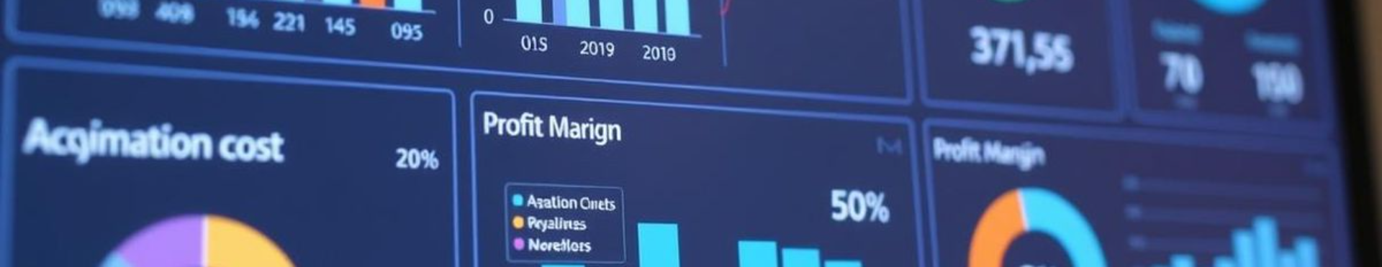




Key Performance Indicators (KPIs)
Sales Revenue
Units Sold
Conversion Rate
Advertising Cost of Sale (ACoS)
SUM(Sales[Price] * Sales[Quantity])
SUM(Sales[Quantity])
(Total Orders / Total Page Views) * 100
Target: 10% QoQ increase.
(Advertising Spend / Sales Revenue) * 100
Target: 15% YoY increase.
Benchmark: 3-5%.
Goal: Below 25%.

Slide 4

Power BI Dashboard: Sales Performance
1
Sales Trend Analysis
2
Product Performance
Line chart showing sales revenue over time.
Bar chart ranking products by sales revenue.
3
Geographic Performance
Map visualizing sales revenue by region.

Slide 5
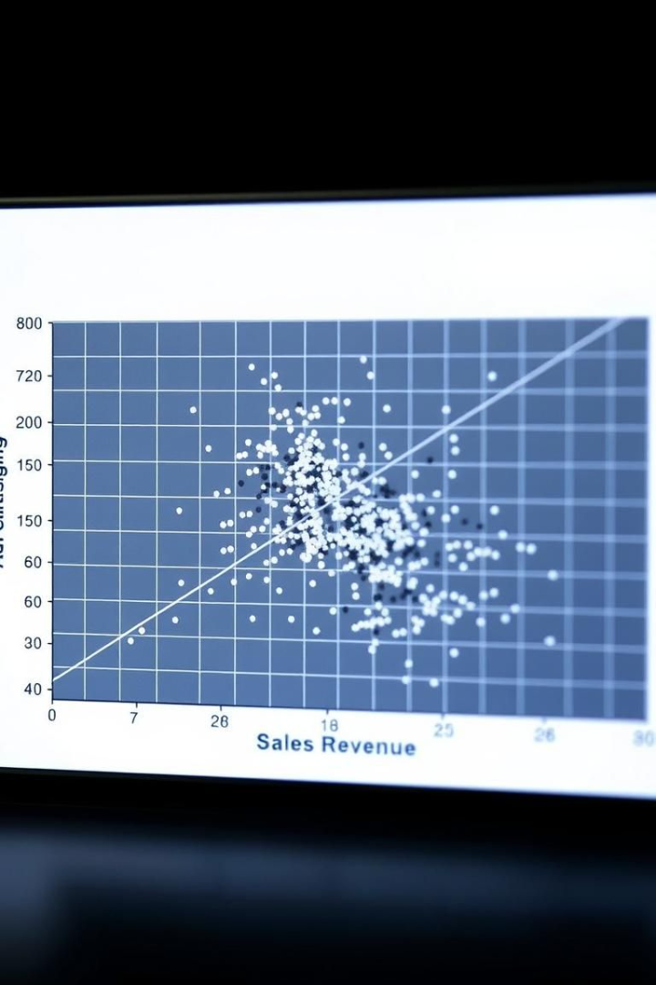
Power BI Dashboard: Advertising Performance
Campaign Performance
Keyword Performance
Table displaying advertising campaign metrics.
Word cloud visualizing top-performing keywords.
Advertising Spend vs. Sales
Scatter plot comparing advertising spend to sales revenue.

Slide 6
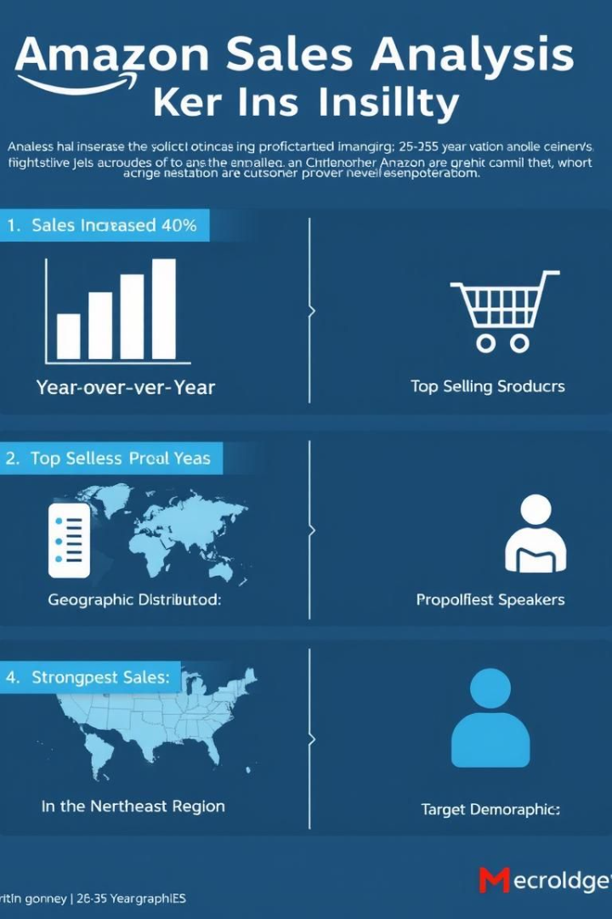
Insights and Findings
1
Sales Trends
Sales revenue increased by 20% YoY.
2
Product Performance
Top 10 products account for 60% of sales.
3
Advertising Performance
ACoS is 30% for the electronics category.
4
Geographic Performance
US and Germany are top regions.

Slide 7
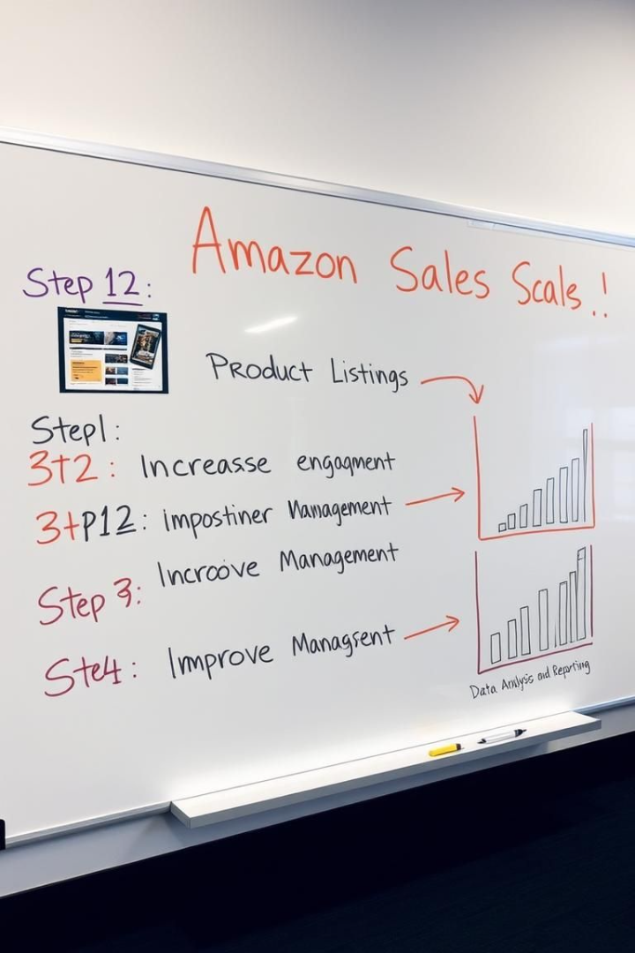




Recommendations and Actionable Items
Advertising Optimization
Reduce ACoS by 5%.
Product Promotion
Launch targeted campaigns.
Geographic Expansion
Invest in marketing efforts.
Inventory Management
Optimize inventory levels.

Slide 8
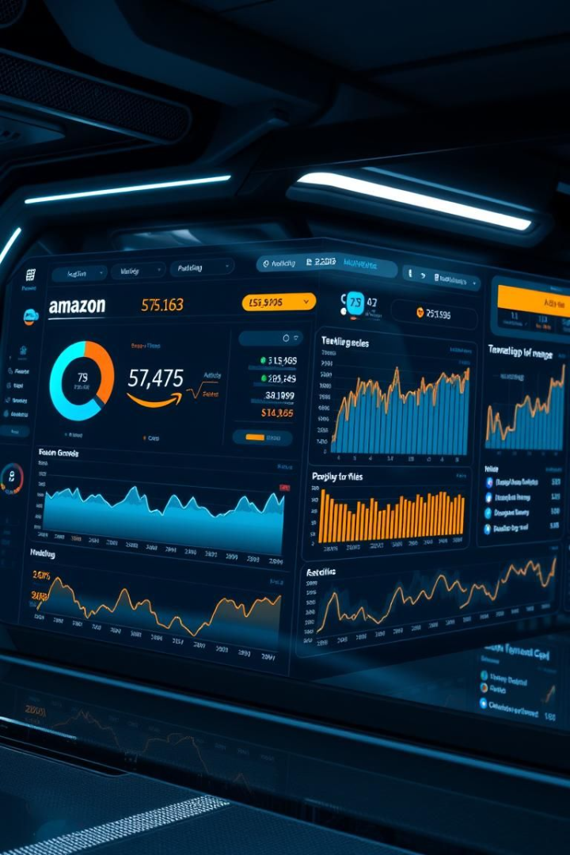
Conclusion and Future Enhancements
Additional Data Sources
Integrate customer reviews.
Predictive Analytics
Forecast sales and demand.
Real-Time Dashboard
Monitor performance.
Automate Data Refresh
Report distribution.

